Slide 1
Linked list script slides

Slide 2
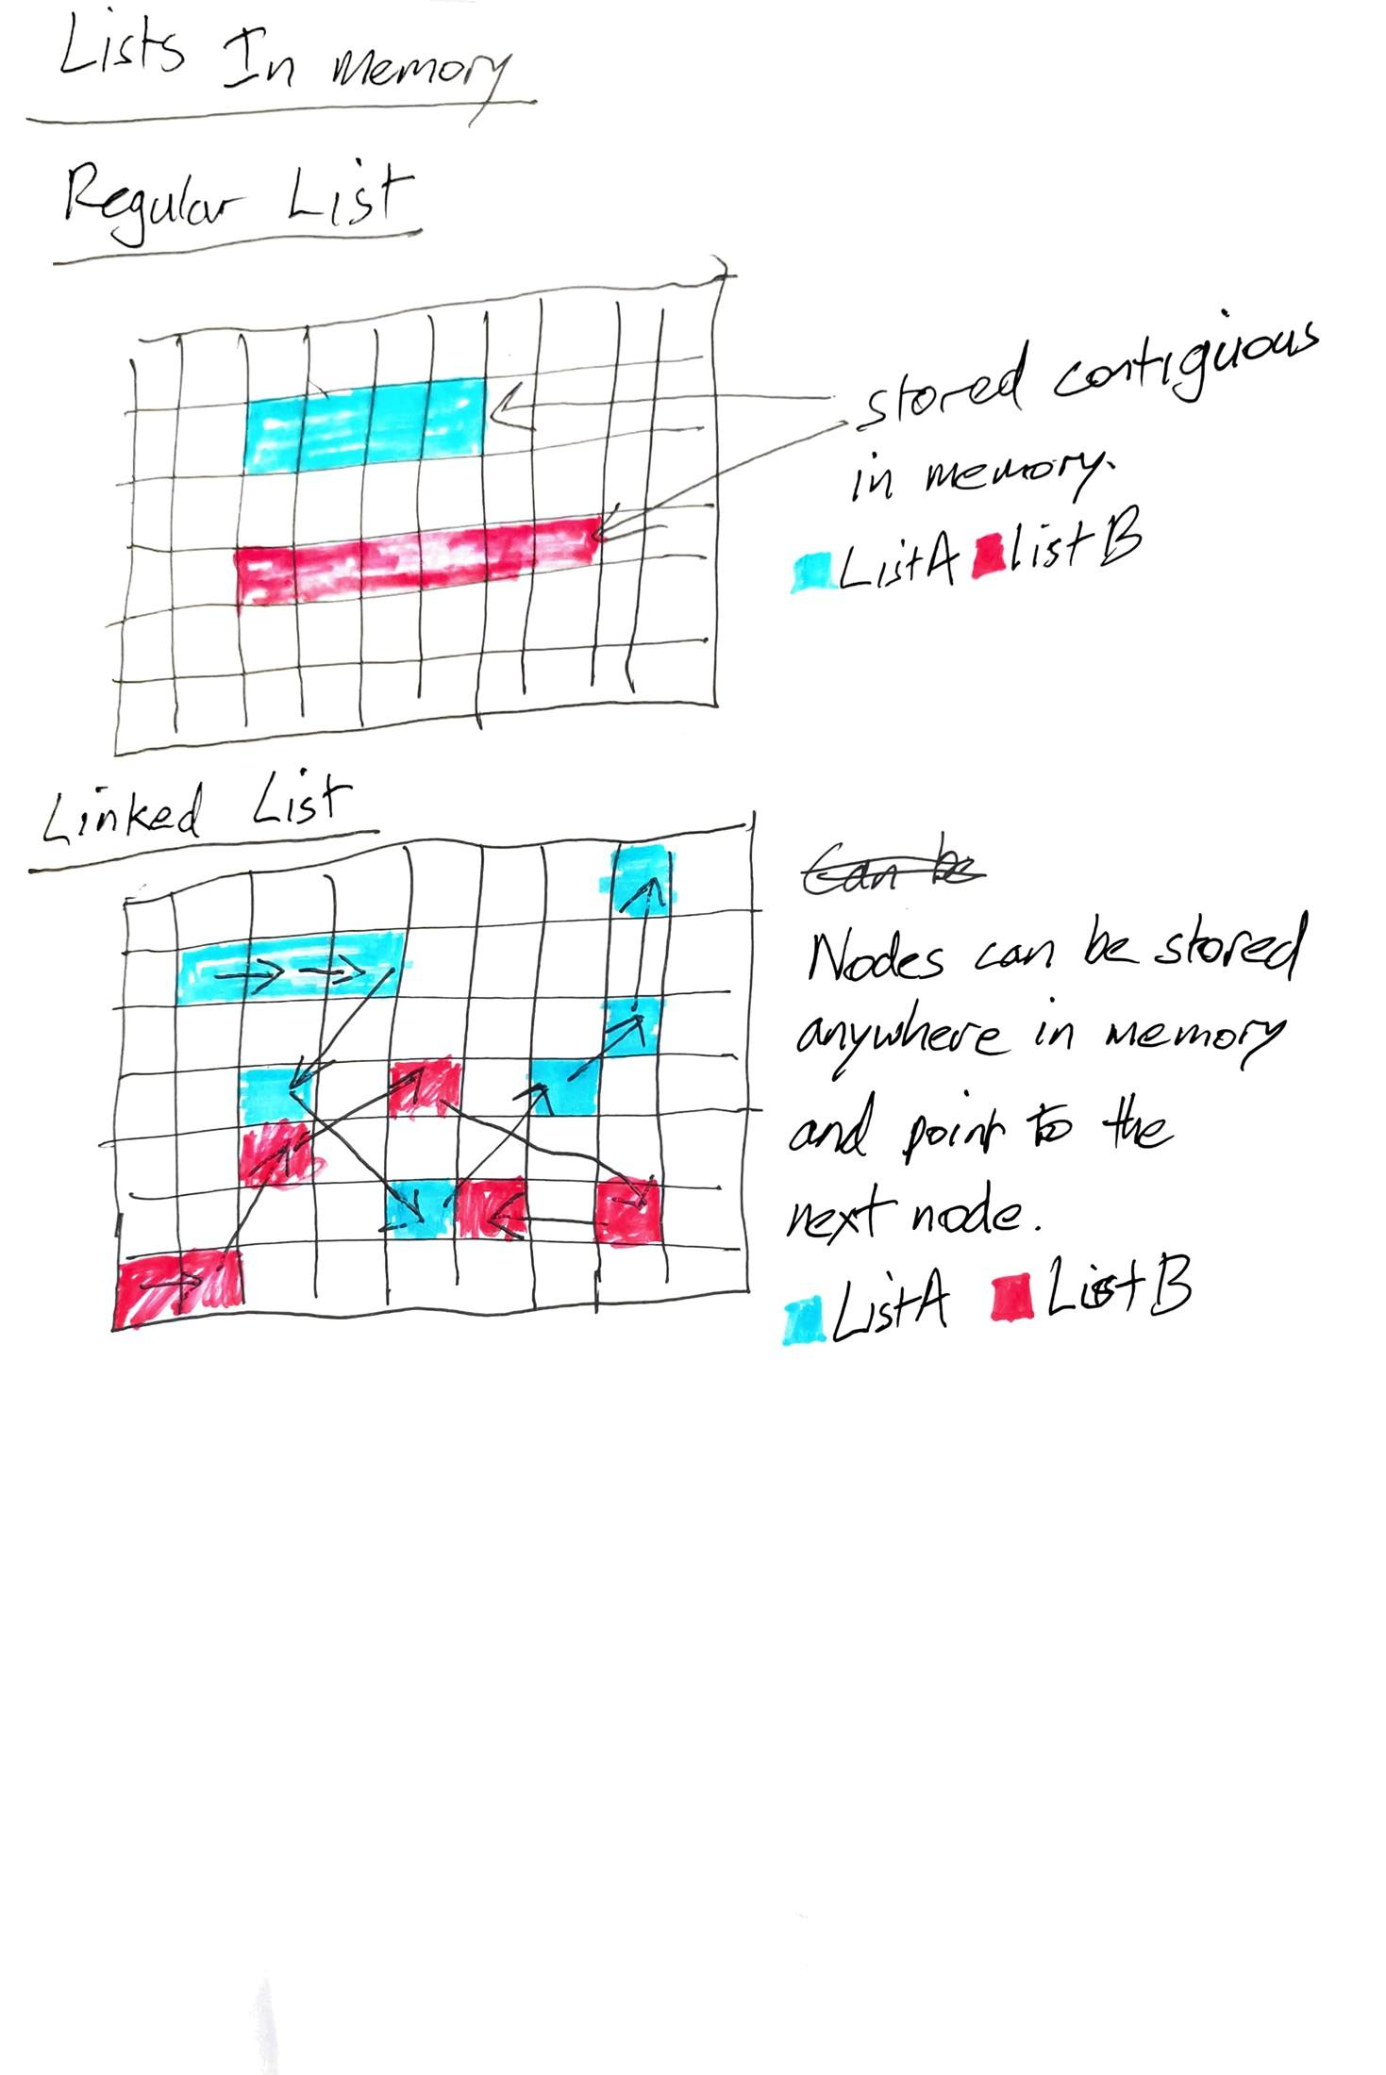

Slide 3
Adding elements to a list

Slide 4
Adding to linked list

Slide 5

Circular Linked List

Slide 6
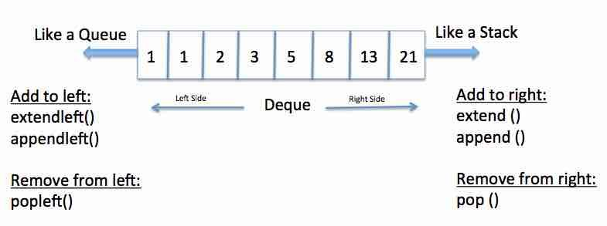
Double Ended Queue

Slide 7
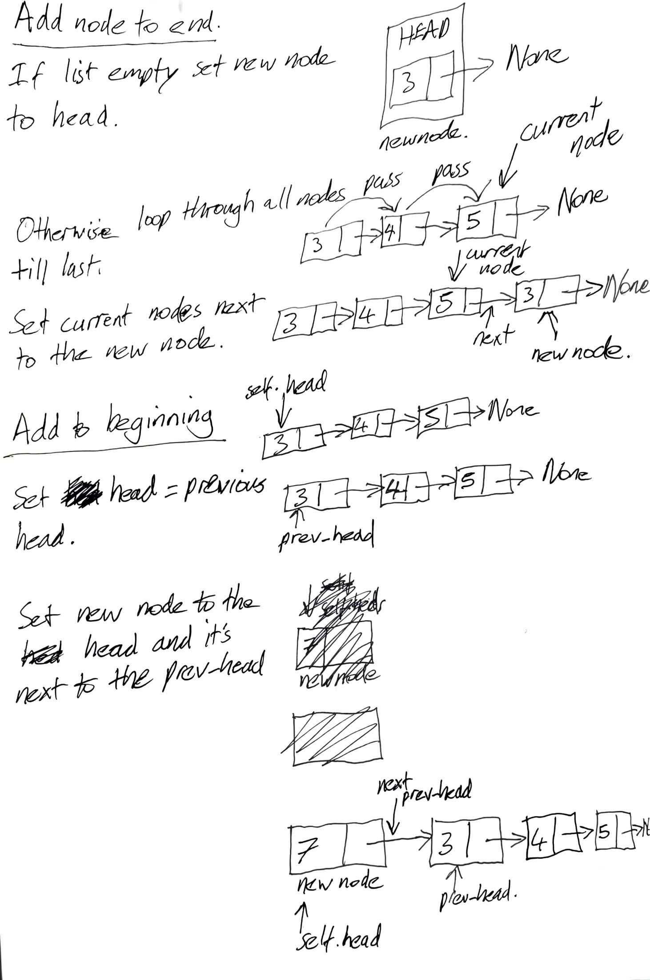

Slide 8
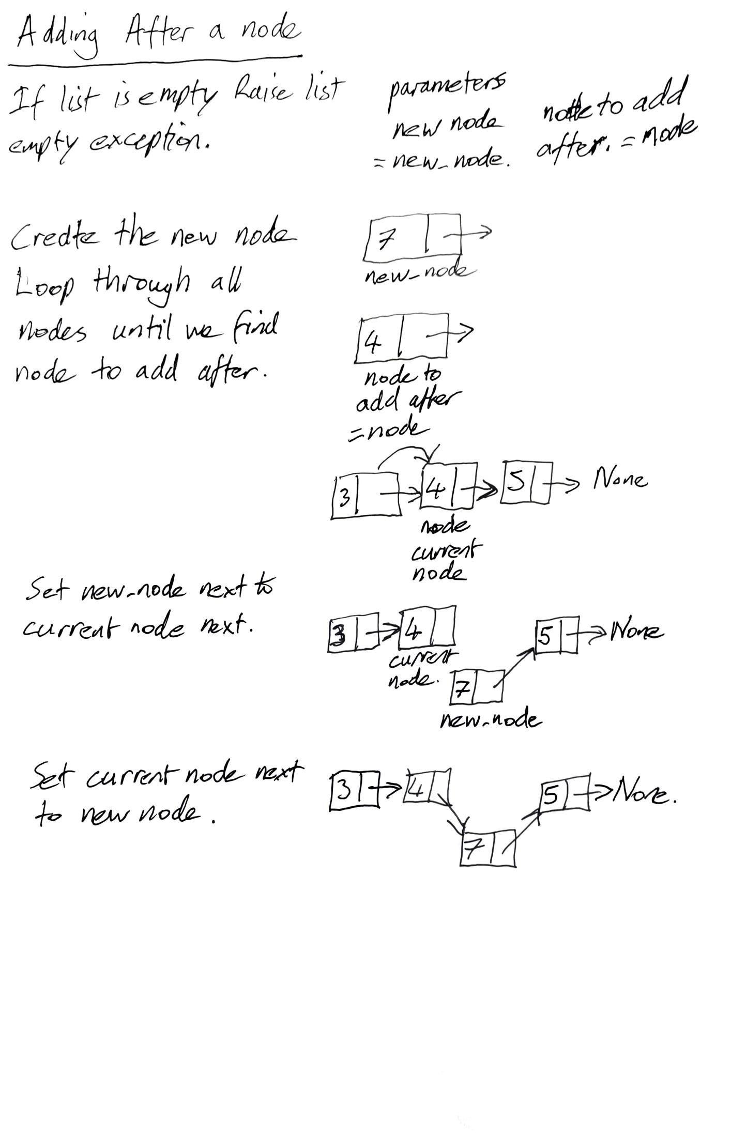

Slide 9
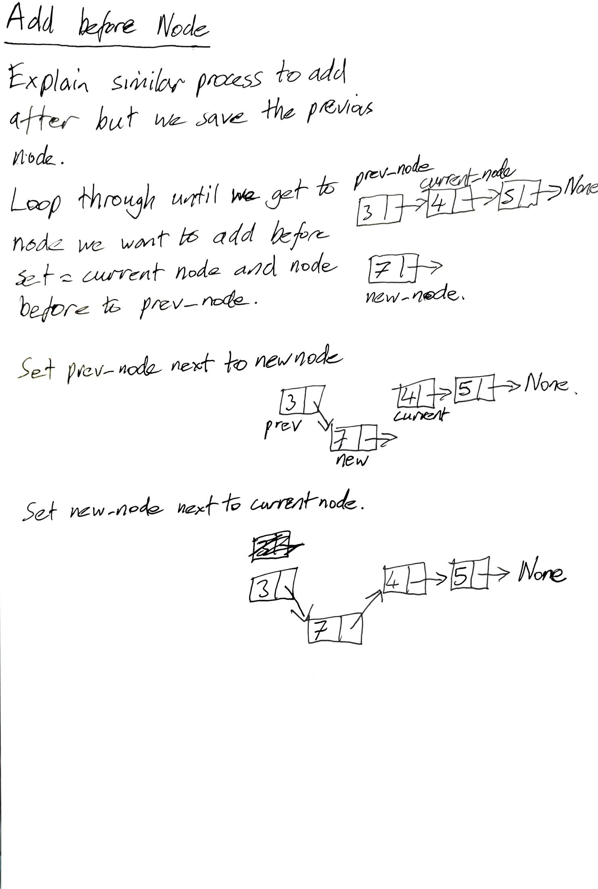

Slide 10
